Slide 1

Course : COMP6176 / Human - Computer Interaction
Year : 2019
SOCIAL INTERACTION
SESSION 04

Slide 2
LEARNING OUTCOMES
• LO 1: Describe the concept of interaction
design
• LO 2: Use guidelines, principles ,models,
and framework related with interaction
design

Slide 3
OUTLINE
^{Introduction}
^{Being Social}
^{Face-to-Face Conversations}
^{Remote Conversations}
^{Co-Presence}
^{Sosial Engagement}

Slide 4

INTRODUCTION
Many people now cannot go for very long without checking the latest postings, emails, etc on their blackberry,iPhone or computer even on vacation.
This is not surprising given that humans are inherently social : they live together, work together, learn together, play together, interact and talk with each other and socialize.
The emergence of a diversity of communication technologies has changed the way people live – the way they keep in touch, make friends, and coordinate their social networks.

Slide 5
BEING SOCIAL
A fundamental aspect of everyday life is being social – interacting with each others.
Continuously update each other about news, changes, and development on a given project, activity, person, or event.
While face-to-face conversations remain central to many of our social interactions, the use of social media has dramatically increased.
Many of us now routinely spend several hours a day communicating online( texting, emailing, Twittering, Facebooking, Skyping, instant messaging, and so on.
The way we make contact, how we stay in touch, who we connect to, and how we maintain our social networks, and family ties have irrevocably changed.

Slide 6
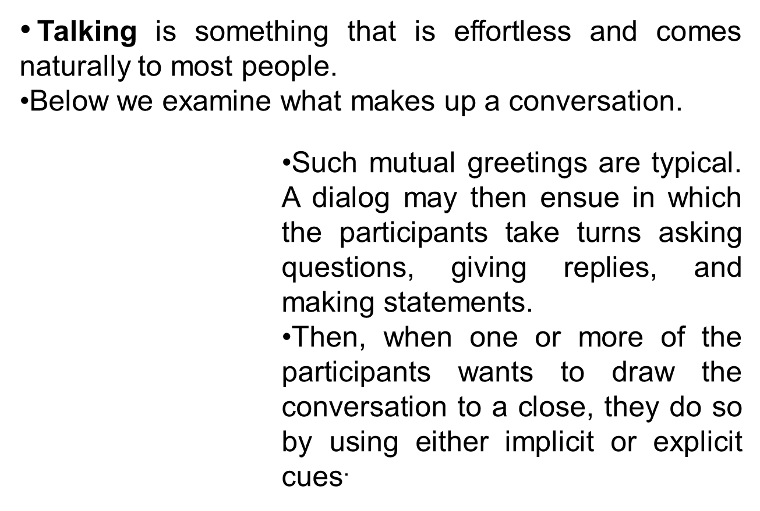
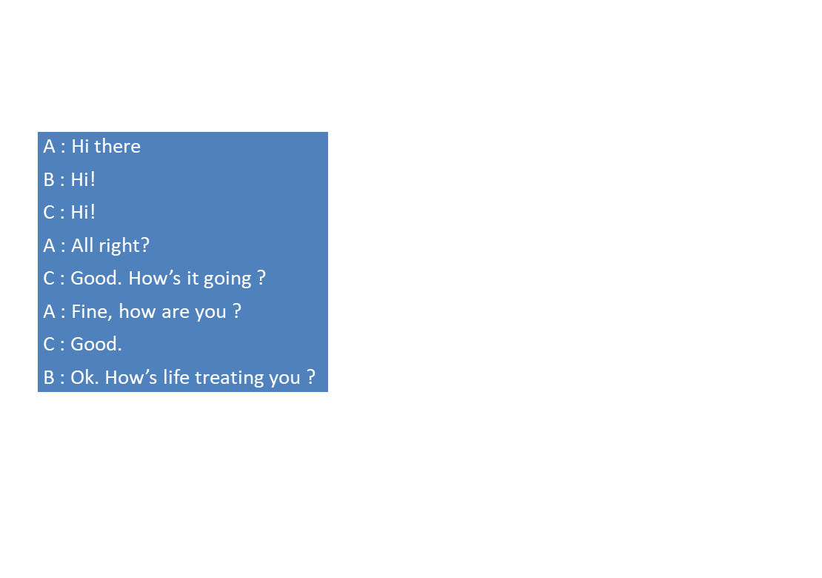
FACE-TO-FACE CONVERSATION

Slide 7
FACE-TO-FACE CONVERSATION
Sacks et al ( 1978) describe conversation in three basic rules :
  Rule 1 : the current speaker chooses the next speaker by asking a question, inviting an opinion, or making a request.
  Rule 2 : another person decides to start speaking.
  Rule 3 : the current speaker continues talking.
The rules are assumed to be applied in the above order, so that whenever there is an opportunity for a change of speaker to occur, e.g. Someone comes to the end of a sentence, rule 1 is applied.

Slide 8
FACE-TO-FACE CONVERSATION
If the listener to whom the question or request is addressed does not accept the offer to take the floor, the second rule is applied and someone else taking part in the conversation may take up the opportunity and offer a view on the matter.
If this does not happen then the third rule is applied and the current speaker continues talking. The rules are cycled through recursively until someone speaks again.

Slide 9
REMOTE CONVERSATION
The telephone was invented in nineteenth century, enabling two people to talk to one another at a distance.
A number of other technologies have been developed that support synchronous remote conversation , including videophone, video chat, and VoIP.
The idea was to allow people to interact with each other via the video technology in a similar way to how they do when walking down a physical halfway.
For example : Hydra system (figure..and VideoWindow ( figure)

Slide 10
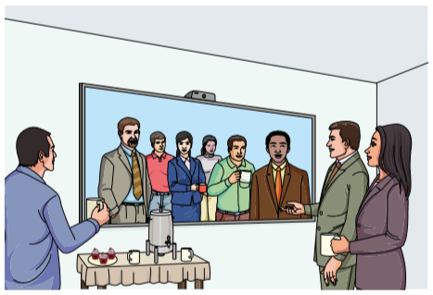
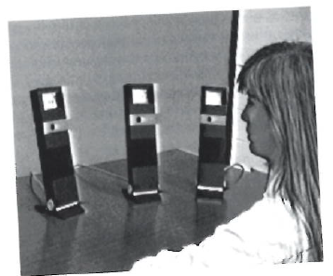
REMOTE CONVERSATION
For example : Video Window (Fig. 04.01) and The Hydra System (Fig. 04.02) consist of a camera, monitor, and speaker and it meant to act as a surrogate for a person in a different space.
Figure 04.02 The Hydra System
Figure 04.01 Diagram of Video Window

Slide 11
REMOTE CONVERSATION
The range of synchronous and asynchronous technologies that have been developed and experimented with to support communication and interaction at a distance are collectively referred to in Computer-Supported Cooperative Work (CSCW) and HCI as computer-mediated communication (CMC).
Some communication technologies are not strictly computer-based ( e.g. Phones, videoconferencing) they are considered to be CMC, as most are display-based and interact with or controlled via an interface.

Slide 12
REMOTE CONVERSATION
For example Skype. Family who live in different places now regularly keep in touch with each other via Skype for daily, weekly and special occasion catch-up.
Other example , SecondLife, a popular genre for work, studying, and play, where people meet, carry out activities and socialize online. To interact in a virtual world, users need to present themselves in the form of a graphical avatar that is visible to others.
VoIP works better for small groups as it is difficult to distinguish between more than a few voices whereas text can be used for much larger groups.

Slide 13
REMOTE CONVERSATION
Twitter and Facebook conversations have also evolved their own particular style of interaction. Posting a status update and tweeting encouraging a one to many broadcasting conversation, where people update their multiple friends and followers
Onine chatting and instant messaging have also their own forms of expression that compensate for the constraints of the medium, such as frequent use of shorthand, abbreviations, and emoticons.

Slide 14
CO-PRESENCE
Together with telepresence, there has been much interest in enhancing co-presence, that is, supporting people in their activities when interacting in the same physical space.
Numerous shareable interfaces have been developed to enable more than one person to use them at the same time.
The motivation is to enable co-located groups to collaborate more effectively when working, learning, and socializing.
Example of commercial products that support this kind of parallel interaction are Smartboards, and Surfaces, which use multitouch, and Wii and Kinect, which use gesture and object recognition.

Slide 15
CO-PRESENCE
To understand how to support and enhance co-located collaboration and gaming, first consider the coordinating and awareness mechanisms already in use by people in face-to-face interaction and then how these have been adapted or replaced.
Physical Coordination
When people are working closely together they talk to each other, issuing commands, and letting others know how they are progressing. Sometimes using gestures.
Various kinds of hand signals have evolved with their own set of standardized syntax and semantics.

Slide 16
CO-PRESENCE
b. Awareness
Awareness involves knowing who is around, what is happening and who is talking with whom. (Dourish,and Bly 1992).
A specific kind of awareness is peripheral awareness. This refers to a person’s ability to maintain and constantly update a sense of what is going on in the physical and social context, thorough keeping an eye on what is happening in the periphery of their visions.

Slide 17
CO-PRESENCE
Situational awareness refers to being aware of what is happening around you in order to understand how information, events, and your own actions will affect ongoing and future events.
Having good situational awareness is critical in –
technology-rich work domains such as air traffic
control.

Slide 18
CO-PRESENCE
Shareable Interfaces.
How might shareable technologies be designed to exploit existing form of coordination and awareness mechanism ?
A study by Rogers et al (2009) showed that a tabletop that allowed group members to add digital content by using physical tokens , using a RFID ( radio-frequency identification) reader, resulted in more equitable participation than if only digital input was allowed via icons and menus at the tabletop.

Slide 19
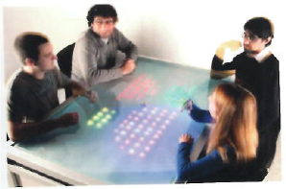
CO-PRESENCE
For example The Reflect Table (fig. 04.03 )
Figure 04.03 The Reflect Table

Slide 20
CO-PRESENCE
In the Reflect Table, the table monitors and analyses ongoing conversations using embedded microphones in front of each person and represents this in the form of increasing members of colored LEDs .
interactive shared display have been placed in various public spaces e.g reception areas, or shopping malls with the aim of encouraging people to meet, interact, with each other and socialize.

Slide 21
SOCIAL ENGAGEMENT
Social engagement refers to participation in the activities of a social group. Often it involves some form of social exchange where people give or receive something from others. Another defining aspect is that it is voluntary and unpaid.
For example, there are many websites now that support pro-social behavior by offering activities intended to help others. One of the first websites of this ilk was GoodGym (www.goodgym.org/), which connects runners with isolated older people.

Slide 22
SOCIAL ENGAGEMENT
Not only has the Internet enabled local people to meet who would not have otherwise, it has proven to be a powerful way of connecting millions of people with a common interest in ways unimaginable before.
An example is retweeting a photo that resonates with a large crowd who finds it amusing and wants to pass it on further.
Another way that Twitter connects people rapidly and at scale is when unexpected events and disasters happen. Those who have witnessed something unusual may upload an image that they have taken of it or retweet what others have posted to inform others about it.

Slide 23

SOCIAL ENGAGEMENT
Figure 04.04 Carter Wilkerson’s tweet that went viral

Slide 24
SOCIAL ENGAGEMENT (Your turn)
Dilemma
Is It OK to Talk with a Dead Person Using a Chatbot ?

Slide 25
REFERENCES
Interaction Design 5th Edition 2019, Chapter 5
https://opentextbc.ca/introductiontosociology2ndedition/chapter/chapter-22-social-interaction/
https://hci.cs.wisc.edu/project/understanding-mobility-in-telepresence/

